Slide 1


AUTOMATION PROJECT
SEPTEMBER 2025
orangehrm.com

Slide 2

INTRODUCTION
We focus on Automation Testing using Selenium with TestNG workframe which is a trusted tools among QA Engineers to ensure implementation quality, and to meet the Software Requirment Specification.

Slide 3

OUR TEAM
01
Wajiha
02
Nagham
03
Mohammad
04
Ahmad
Tester
Tester
Tester
Tester

Slide 4


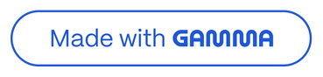
Presentation Overview
1
2
3
Workflows & Requirements
Purpose & Objectives
Application Details
Set the stage for our comprehensive QA findings.
Key system information and scope of testing.
Core business processes and critical needs.
4
5
Test Specifications & Execution
Observations & Recommendations
Methodology, coverage, and summary of results.
Key findings and actionable next steps for improvement.

Slide 5
OBJECTIVES
Practicing real life testing project scinario
Collaborating and communicating between the team members.
Automate critical test cases in OrangeHRM
Reduce manual testing time and effort
Improve accuracy and consistency of test execution
Hands-on with Selenium + Java + TestNG
Ensure HRM modules work correctly

Slide 6






STLC
REQUIREMENT ANALYSIS
DESIGN TEST PLAN
DESIGN TEST CASES
SUBMIT
DOCUMENTATION
TESTS IMPLEMENTATION

Slide 7
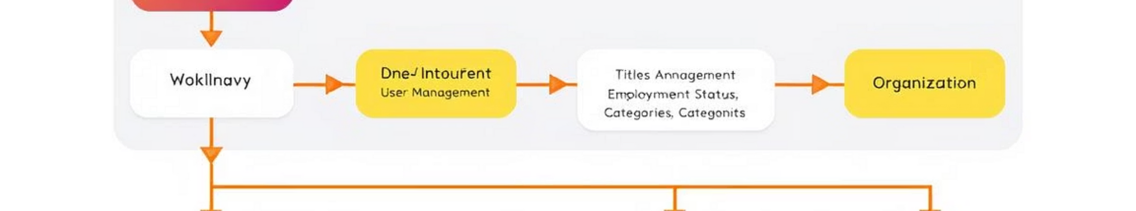
Core Application Workflows
Our testing covered the essential administrative workflows within OrangeHRM, ensuring smooth and accurate operation for HR tasks.
Login Workflow
User Management
Secure authentication for HR administrators.
Full lifecycle management of system users.
Job & Organization Data
Qualifications Management
Configuration of job roles, pay structures, and company organizational details.
Tracking employee skills, education, and language proficiencies.

Slide 8








Critical Business Requirements
Centralized Control
Role-Based Access & Audit
A single, unified platform for all HR administration tasks.
Ensuring appropriate access levels and detailed logging of actions.
Data Consistency & Integrity
Security, Compliance & Configuration
Robust protection of sensitive data, adherence to regulations, and flexible settings.
Maintaining accurate and reliable HR data across the system.
These requirements formed the backbone of our testing strategy, validating the system's ability to meet core HR operational needs securely and efficiently.

Slide 9
SRS DOCUMENTATION HIGHLIGHTS
Business Requirements
Secure admin authentication
Efficient user role management
Comprehensive job structure setup
Qualifications and skills tracking
Organizational hierarchy management
Functional Requirements
Role-based access control
CRUD operations for all entities
Data validation and error handling
Bulk operations support
Real-time notifications

Slide 10
TOOLS & TECHNOLOGIES
Programming Language: Java
Automation Tool: Selenium WebDriver
Test Framework: TestNG
Build Tool: Maven
IDE: Eclips, IntelliJ IDEA
Browser: Chrome

Slide 11
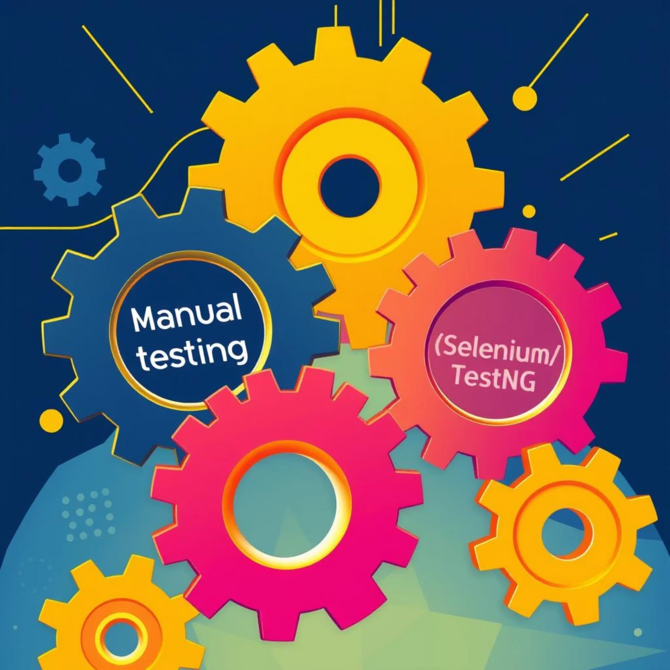
Test Specifications & Methodology
Hybrid Testing Approach
We employed a blended approach, combining meticulous manual testing with robust automation, to maximize coverage and efficiency.
Manual Testing: Focused on edge cases, usability, and exploratory scenarios.
Automation Testing: Utilizing Selenium with TestNG and Java for repeatable functional tests.
Coverage & Environment
Functional Scope: Comprehensive CRUD (Create, Read, Update, Delete) operations and workflow validation across all modules.
Automation Goal: Achieved 80-100% automation coverage per module for efficiency.
Test Environment: Consistent testing across Chrome and Firefox browsers on Windows 10/11 laptops and PCs.

Slide 12
TEST SCOPE (MODULES TESTED)
HR Admin Authentication
User Management
Job Management
Organization General Information
Qualifications Management

Slide 13
TEST CASES DESIGN
HR Admin Authentication → 26 Test Cases
User Management → 71 Test Cases
Job Management → 47 Test Cases
Organization Structure → 40 Test Cases
Qualifications Management → 22 Test Cases

Slide 14
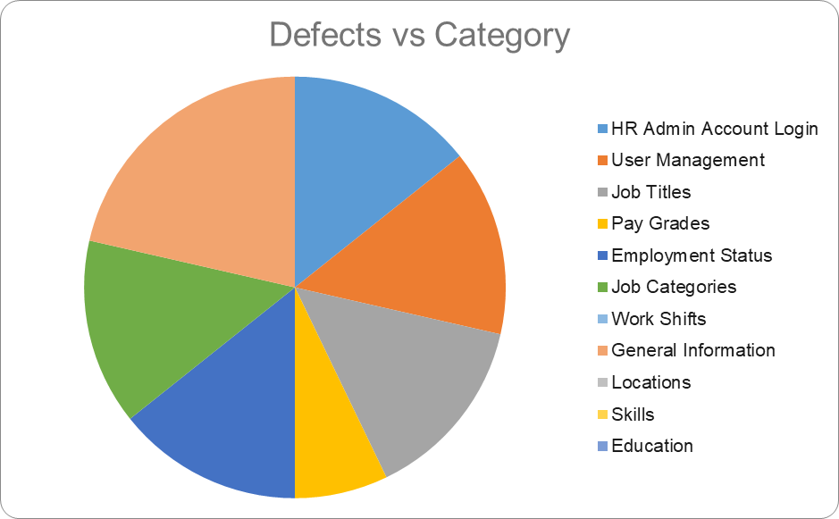
TEST CASES DESIGN

Slide 15

Module-Wise Results & Defects
Module
TC Passed %
Priority
Defects
Login
92%
High
2
User Management
97%
High
2
Job Titles
80%
Medium
2
Pay Grades
90%
Medium
1
Employment Status
75%
Medium
2
Job Categories
78%
Medium
2
Work Shifts
100%
Medium
0
General Info
81%
High
3
Locations
100%
High
0
Skills / Education / Languages
100%
Medium
0
Modules like Login, User Management, and General Info show high-priority defects, indicating critical areas for immediate developer attention. Work Shifts, Locations, and Qualifications modules passed with 100% success.

Slide 16
CHALLENGES FACED
Locating dynamic elements without IDs
Handling synchronization issues (waits)
Maintaining test scripts for different modules

Slide 17



RTM Highlights & Critical Defects
The Requirements Traceability Matrix (RTM) provides a clear link from business requirements to test cases and identified defects.
Requirements
Test Cases
Bugs
The foundational business needs.
Specific scenarios designed to validate requirements.
Identified discrepancies or failures.
Critical Failures Identified:
Login (Req-01): TC001–TC026 resulted in Bug-01/02. These critical defects impact user access and system security.
User Management (Req-02): TC027–TC097 exposed Bug-03/04, affecting core HR administrative functions.
Work Shifts (Req-3.5): TC135–TC144 passed with no issues, confirming this module's stability.

Slide 18

Test Execution Summary
Our rigorous testing process concluded with the following results, demonstrating the current stability and areas requiring attention.
All test cases were executed, with no pending, blocked, or in-progress items remaining. The focus now shifts to addressing the identified failures.

Slide 19

Conclusion & Recommendations
Key Achievements
Comprehensive Testing: The test plan was executed fully per the Software Requirements Specification (SRS).
Extensive Coverage: All 204 test cases were run, ensuring thorough validation of OrangeHRM 5.7.
Automation Benefits: Automated tests significantly improved coverage, repeatability, and efficiency of the QA process.
Next Steps
Prioritize Bug Fixes: Immediate action is required on the 14 failed test cases, particularly the high-priority bugs in Login, User Management, and General Info, before production deployment.
Regression Testing: Conduct targeted regression testing post-bug fixes to ensure no new issues are introduced.
Continuous Improvement: Integrate automation into the CI/CD pipeline for ongoing quality assurance.
QA Lead Approval: Ahmed Abdallatif

Slide 20
Q & A

Slide 21
THANK YOU
01
Wajiha
02
Nagham
03
Mohammad
04
Ahmad
Tester
Tester
Tester
Tester

